Slide 1
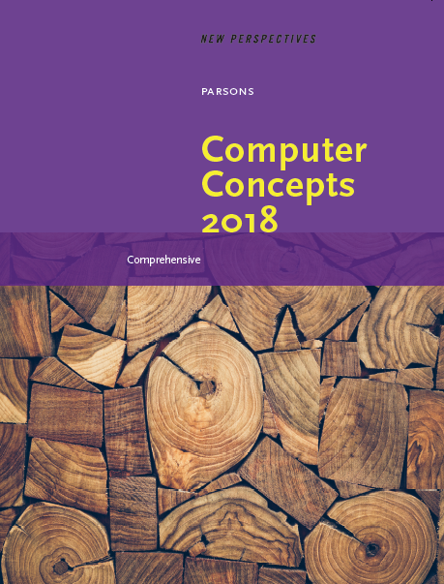

Computer Concepts 2018
Module 11
Programming
© 2019 Cengage. All rights reserved.

Slide 2
Module Contents
Section A: Program Development
Section B: Programming Tools
Section C: Procedural Programming
Section D: Object-Oriented Programs
Section E: Declarative Programming

Slide 3
Section A: Program Development
Programming Basics
Program Planning
Writing Programs
Program Testing and Documentation

Slide 4
Section A: Objectives (1 of 2)
Describe the difference between programming and software engineering
List the three core elements of a problem statement and provide an example of each
Supply at least three examples of projects that would be best tackled using predictive methodology and three projects best tackled using agile methodology
Describe the difference between constants and variables, and provide an example of how each would be used in a program

Slide 5
Section A: Objectives (2 of 2)
List three types of errors that might be encountered during program testing
Explain the significance of formal methods
Explain the purpose of STRIDE and DREAD
Explain the significance of defensive programming

Slide 6
Programming Basics (1 of 3)
Computer programming encompasses a broad set of activities that include planning, coding, testing, and documenting
A related activity, software engineering, is a development process that uses mathematical, engineering, and management techniques to reduce the cost and complexity of a computer program while increasing its reliability and modifiability
Software engineering can be characterized as more formalized and rigorous than computer programming

Slide 7
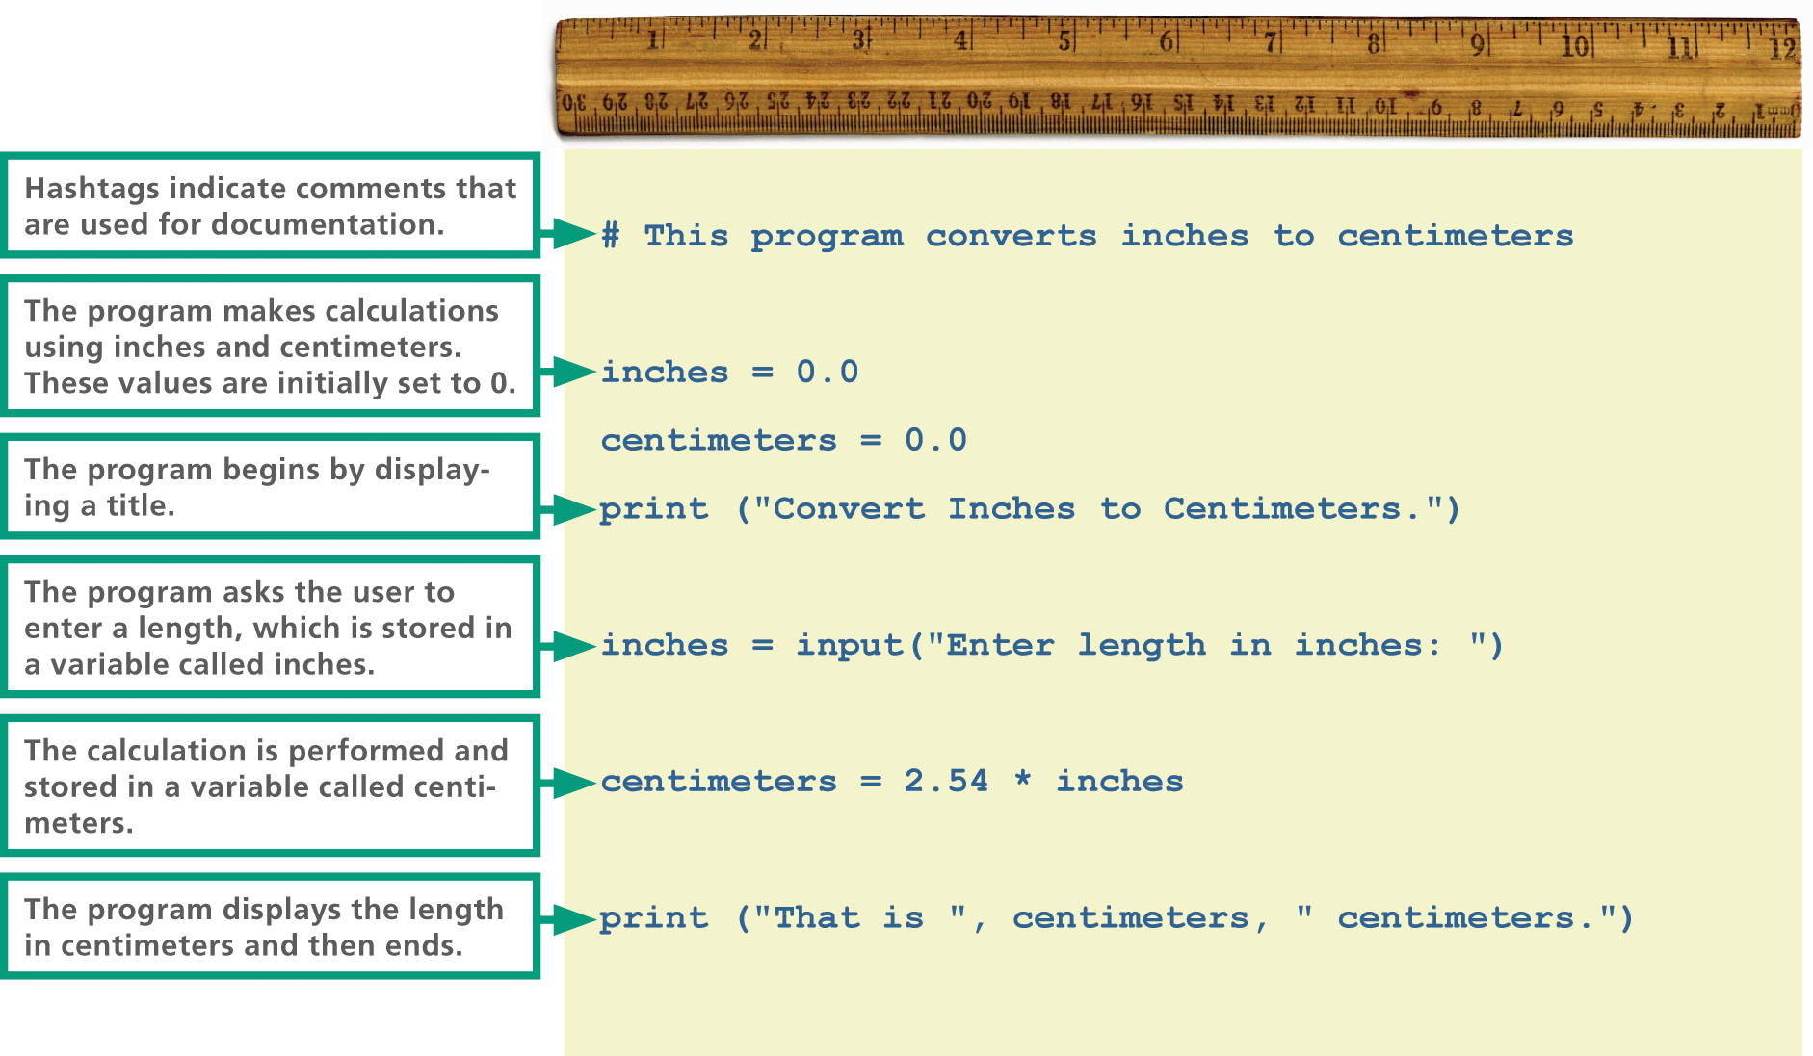
Programming Basics (2 of 3)

Slide 8
Programming Basics (3 of 3)
Programmers typically specialize in either application programming or system development
Application programmers create productivity applications such as Microsoft Office
Systems programmers specialize in developing system software such as operating systems, device drivers, security modules, and communications software

Slide 9
Program Planning (1 of 3)
In the context of programming, a problem statement defines certain elements that must be manipulated to achieve a result or goal
A good problem statement for a computer program has three characteristics:
It specifies any assumptions that define the scope of the problem
It clearly specifies the known information
It specifies when the problem has been solved

Slide 10
Program Planning (2 of 3)
In a problem statement, an assumption is something you accept as true in order to proceed with program planning
The known information in a problem statement is the information that is supplied to the computer to help it solve a problem
After identifying the known information, a programmer must specify how to determine when the problem has been solved

Slide 11
Program Planning (3 of 3)
Several software development methodologies exist to help program designers and coders plan, execute, and test software
Methodologies can be classified as predictive or agile
A predictive methodology requires extensive planning and documentation up front; it’s used to construct buildings and assemble cars—tasks that are well defined and predictable
An agile methodology focuses on flexible development and specifications that evolve as the project progresses

Slide 12
Program Coding (1 of 6)
The core of a computer program is a sequence of instructions
A keyword, or command, is a word with a predefined meaning
Keywords differ depending on the programming language; there is a basic vocabulary that covers most necessary tasks

Slide 13
Program Coding (2 of 6)
input | Collection information from the program’s user.
print | Display information on the screen.
while | Begin a series of commands that will be repeated in a loop.
break | Terminate a loop.
if | Execute one or more instructions only if a specified condition is true.
else | Add more options to extend the if command.
def | Define a series of instructions that become a unit called a function.
return | Transfer data from a function to some other part of the program.
class | Define an object as a set of attributes and methods.

Slide 14
Program Coding (3 of 6)
Keywords can be combined with specific parameters, which provide more detailed instructions for the computer to carry out
These parameters include variables and constants
A variable represents a value that can change
A constant is a factor that remains the same throughout a program

Slide 15
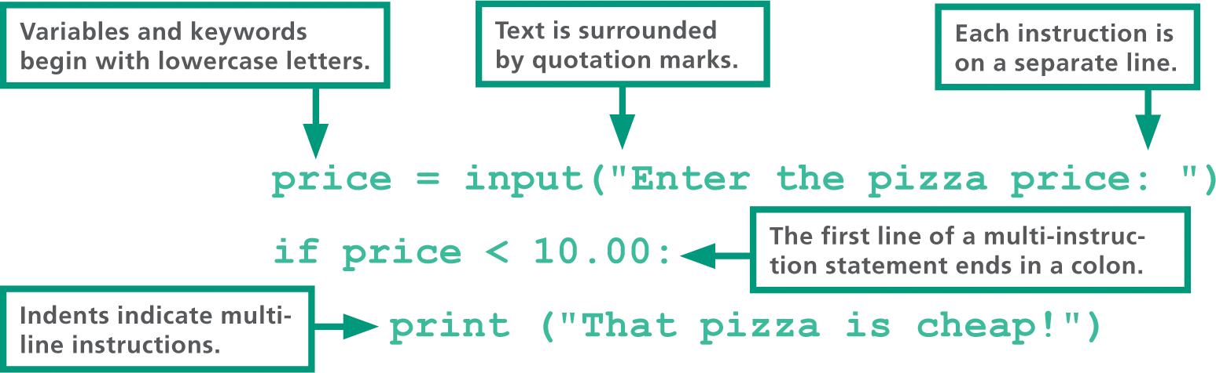
Program Coding (4 of 6)
The set of rules that specify the sequence of keywords, parameters, and punctuation in a program instruction is referred to as syntax

Slide 16
Program Coding (5 of 6)
You may be able to use a text editor, program editor, or graphical user interface to code computer programs
A text editor is any word processor that can be used for basic text editing tasks, such as writing email, creating documents, and coding computer programs
A program editor is a type of text editor specially designed for entering code for computer programs
A VDE (visual development environment) provides programmers with tools to build substantial sections of a program by pointing and clicking rather than typing each statement

Slide 17
Program Coding (6 of 6)
Frequently used controls include labels, menus, toolbars, list boxes, text boxes, option buttons, check boxes, and graphical boxes
A control can be customized by specifying values for a set of built-in properties

Slide 18
Program Testing and Documentation (1 of 9)
Programs that don’t work correctly might crash, run forever, or provide inaccurate results; when a program isn’t working, it’s usually the result of a runtime, logic, or syntax error
A runtime error occurs when a program runs instructions that the computer can’t execute
A logic error is a type of runtime error in the logic or design of the program
A syntax error occurs when an instruction does not follow the syntax rules of the programming language

Slide 19

Program Testing and Documentation (2 of 9)
Omitting a keyword, such as ELSE
Misspelling a keyword, such as mistakenly typing PIRN instead of PRINT
Omitting required punctuation, such as a period, comma, or bracket
Using incorrect punctuation, such as typing a colon where a semicolon is required
Forgetting to close parentheses

Slide 20
Program Testing and Documentation (3 of 9)
The process of finding and fixing errors in a computer program is called debugging
Programmers can locate errors in a program by reading through each line, much like a proofreader
Programmers also insert documentation called remarks (or comments) into the program

Slide 21
Program Testing and Documentation (4 of 9)
Programs need to meet performance, usability, and security standards
Performance – programmers need to carry out real-world tests to ensure that programs don’t take too long to load
Usability – programs should be easy to learn and use and be efficient
Security – program specifications are formulated so that programmers remain aware of security throughout the software development life cycle

Slide 22
Program Testing and Documentation (5 of 9)
Formal methods help programmers apply rigorous logical and mathematical models to software design, composition, testing, and verification
Threat modeling (also called risk analysis) is a technique that can be used to identify potential vulnerabilities by listing the key assets of an application, categorizing the threats to each asset, ranking the threats, and developing threat mitigation strategies that can be implemented during programming

Slide 23
Program Testing and Documentation (6 of 9)
Spoofing: Pretending to be someone else
Tampering: Changing, adding, or deleting data
Repudiation: Covering tracks to make attacks difficult to trace
Information disclosure: Gaining unauthorized access to information
Denial of service: Making a system unavailable to legitimate users
Elevation of Privilege: Modifying user rights to gain access to data

Slide 24
Program Testing and Documentation (7 of 9)
Damage: How much damage can a particular attack cause?
Reproduce: Is this attack easy to reproduce?
Exploit: How much skill is needed to launch the attack?
Affected: How many users would be affected by an attack?
Discovered: How likely is it that this attack would be discovered?

Slide 25
Program Testing and Documentation (8 of 9)
Defensive programming (also referred to as secure programming) is an approach to software development in which programmers anticipate what might go wrong as their programs run and take steps to smoothly handle those situations
Techniques associated with defensive programming include:
Walkthroughs. Open source software goes through extensive public scrutiny that can identify security holes, but proprietary software can also benefit from a walkthrough with other in-house programmers

Slide 26
Program Testing and Documentation (9 of 9)
Simplification. Complex programs are more difficult to debug than simpler ones. Simplifying complex sections can sometimes reduce a program’s vulnerability to attacks
Filtering input. It is dangerous to assume that users will enter valid input. Attackers have become experts at concocting input that causes buffer overflows and runs rogue HTML scripts. Programmers should use a tight set of filters on all input fields

Slide 27
Section B: Programming Tools
Language Evolution
Compilers and Interpreters
Paradigms and Languages
Toolsets

Slide 28
Section B: Objectives (1 of 2)
Explain how the concept of abstraction applies to programming languages
Provide two examples of low-level languages and five examples of high-level languages
Explain how assemblers are related to compilers
Describe the difference between compiling a program and using an interpreter
List and describe three popular programming paradigms
List at least three legacy programming languages

Slide 29
Section B: Objectives (2 of 2)
List two programming languages used to program mobile apps
List three programming languages that are popular for developing dynamic Web sites
Explain how programmers use IDEs, SDKs, VDEs, and APIs

Slide 30
Language Evolution (1 of 7)
When applied to programming languages, abstraction inserts a buffer between programmers and the chip-level details of instruction sets and binary data representation
For programming languages, abstraction automates hardware-level details, such as how to move data from memory to the processor
A low-level language has a low level of abstraction because it includes commands specific to a particular CPU or microprocessor family
A high-level language uses command words and grammar based on human languages to provide a level of abstraction that hides the underlying low-level language

Slide 31
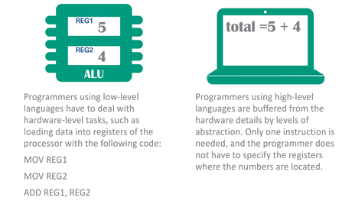
Language Evolution (2 of 7)

Slide 32
Language Evolution (3 of 7)
First-generation languages are the first machine languages programmers used
Second-generation languages added a level of abstraction to machine languages by substituting abbreviated command words for binary numbers
Third-generation languages were conceived in the 1950s and used easy-to-remember command words, such as PRINT and INPUT

Slide 33
Language Evolution (4 of 7)
An assembly language is classified as a low-level language because it is machine specific
An assembler typically reads a program written in an assembly language, which has two parts: the op code and the operand
An op code, which is short for operation code, is a command word for an operation such as add, compare, or jump
The operand for an instruction specifies the data for the operation

Slide 34
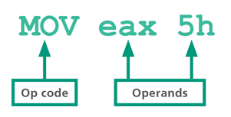
Language Evolution (5 of 7)
Look at the parts of an assembly language shown in the below figure—consider how tedious it would be to write a program consisting of thousands of these concise, but cryptic, op codes:

Slide 35
Language Evolution (6 of 7)
Fourth-generation languages are considered “high-level” languages and more closely resemble human languages
The computer language Prolog, based on a declarative programming paradigm, is identified as a fifth-generation language—though some experts disagree with this classification

Slide 36
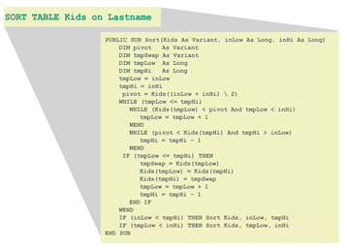
Language Evolution (7 of 7)

Slide 37
Compilers and Interpreters (1 of 3)
The human-readable version of a program created in a high-level language by a programmer is called source code
Source code must first be translated into machine language using a compiler or interpreter
A compiler converts all the statements in a program in a single batch, and the resulting collection of instructions, called object code, is placed in a new file
An interpreter converts and executes one statement at a time while the program is running; once executed, the interpreter converts and executes the next statement

Slide 38
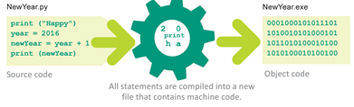
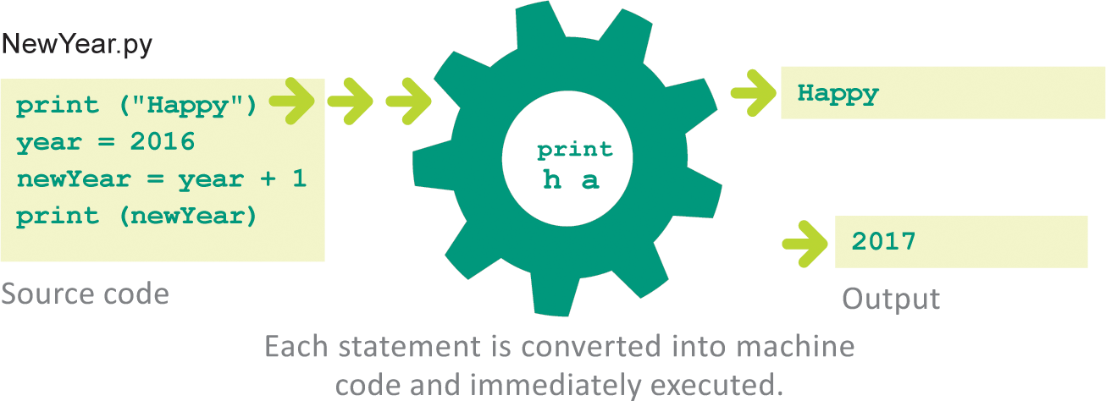
Compilers and Interpreters (2 of 3)

Slide 39
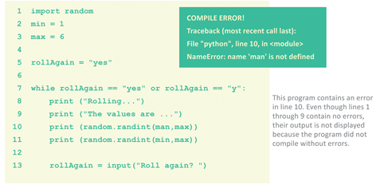
Compilers and Interpreters (3 of 3)

Slide 40
Paradigms and Languages (1 of 4)
The phrase programming paradigm refers to a way of conceptualizing and structuring the tasks a computer performs
A programmer uses a programming language that supports the paradigm
Other programming languages—referred to as mulitparadigm languages—support more than one paradigm

Slide 41
Paradigms and Languages (2 of 4)
PARADIGM | DESCRIPTION
Procedural | Emphasizes linear steps that provide the computer with instructions on how to solve a problem or carry out a task
Object-oriented | Formulates programs as a series of objects and methods that interact to perform a specific task
Declarative | Focuses on the use of facts and rules to describe a problem

Slide 42
Paradigms and Languages (3 of 4)
Programmers generally find it useful to classify languages based on the types of projects for which they are used
Some languages are used for Web programming; others for mobile apps, games, and enterprise applications
Some of the most commonly used programming languages include:
Fortran
LISP
COBOL
BASIC
C
Prolog

Slide 43
Paradigms and Languages (4 of 4)
Ada
C++
Objective-C
Perl
Python
Visual Basic (VB)
Ruby
Java
JavaScript
PHP
C#
Swift

Slide 44
Toolsets (1 of 2)
Serious programmers typically download and install programming tools; their toolbox may include a compiler, a debugger, and an editor
Programmers often download an SDK or IDE that contains a collection of programming tools
An SDK (software development kit) is a collection of language-specific programming tools that enables a programmer to develop applications for a specific computer platform
An IDE (integrated development environment) is a type of SDK that packages a set of development tools into a sleek programming application

Slide 45
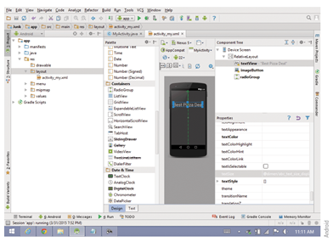
Toolsets (2 of 2)

Slide 46
Section C: Procedural Programming
Algorithms
Pseudocode and Flowcharts
Flow Control
Procedural Applications

Slide 47
Section C: Objectives (1 of 2)
Explain how algorithms relate to procedural programming
List three tools that can be used to express an algorithm during the planning phase of program development
Draw a diagram that illustrates how a function controls program flow
Draw a diagram that illustrates how a selection control structure affects program flow
Draw a diagram that illustrates how a repetition control structure affects program flow

Slide 48
Section C: Objectives (2 of 2)
Describe at least two programming projects that are well suited for the procedural approach
Explain the advantages and disadvantages of the procedural paradigm

Slide 49
Algorithms (1 of 4)
The traditional approach to programming uses a procedural paradigm (sometimes called an imperative paradigm) to conceptualize the solution to a problem as a sequence of steps
A programming language that supports the procedural paradigm is called a procedural language; these languages are well suited to problems that can easily be solved with a linear, step-by-step algorithm

Slide 50
Algorithms (2 of 4)
An algorithm is a set of steps for carrying out a task that can be written down and implemented
For example, the algorithm for making macaroni and cheese is a set of steps that includes boiling water, cooking the macaroni in the water, and adding the cheese sauce
Algorithms are usually written in a format that is not specific to a particular programming language

Slide 51
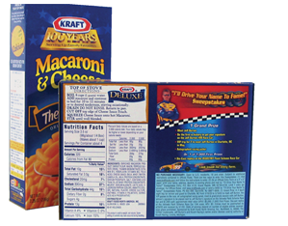
Algorithms (3 of 4)
An important characteristics of a correctly formulated algorithm is that carefully following the steps guarantees that you can accomplish the task for which the algorithm was designed. If the recipe on a macaroni and cheese package is a correctly formulated algorithm, by following the recipe,, you should be guaranteed a successful batch of macaroni and cheese

Slide 52
Algorithms (4 of 4)
An algorithm for a computer program is a set of steps that explains how to begin with known information specified in a problem statement and how to manipulate that information to arrive at a solution
Algorithms are usually written in a format that is not specific to a particular programming language

Slide 53
Pseudocode and Flowcharts (1 of 2)
You can express an algorithm in several different ways, including structured English, pseudocode, and flowcharts
Structured English is a subset of the English language with a limited selection of sentence structures that reflect processing activities
Pseudocode is a notational system for algorithms that is less formal than a programming language
A flowchart is a graphical representation of the way a computer should progress from one instruction to the next as it performs a task

Slide 54
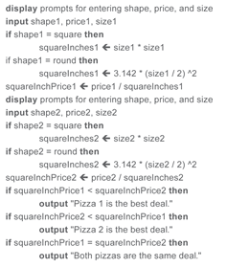
Pseudocode and Flowcharts (2 of 2)

Slide 55
Flow Control (1 of 7)
The key to a computer’s ability to adjust to so many situations is the programmer’s ability to control the flow of a program
Flow control refers to the sequence in which a computer executes program statements
During sequential execution, the first statement in the program is executed first, then the second statement, and so on, to the last statement in the program

Slide 56
Flow Control (2 of 7)
Here is a simple program written in the Python programming language that outputs This is the fist line. and then outputs This is the next line.:
print (“This is the first line.”)
print (“This is the next line.”)

Slide 57
Flow Control (3 of 7)
Control structures are statements that specify the sequence in which a program is executed
A sequence control structure changes the order in which instructions are carried out by directing the computer to execute an instruction elsewhere in the program
In the following simple program, a goto command tells the computer to jump directly to the instruction labeled “Widget”:
print (“This is the first line.”)
goto Widget
print (“This is the next line.”)
Widget: print (“All done!”)

Slide 58
Flow Control (4 of 7)
A function is a section of code that is part of a program but is not included in the main sequential execution path
A sequence control structure directs the computer to the statements contained in a function—when the statements have been executed, the computer returns to the main program

Slide 59
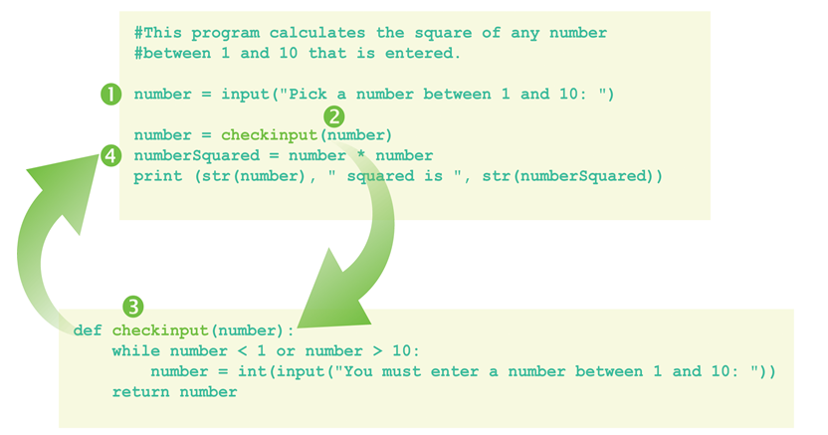
Flow Control (5 of 7)
The program asks the user to enter a number
Next, the program takes the number a jumps to the check input function
In the check input function, the program makes sure the number is between 1 and 10
A valid number between 1 and 10 is returned to the main program, where the number is squared and displayed

Slide 60
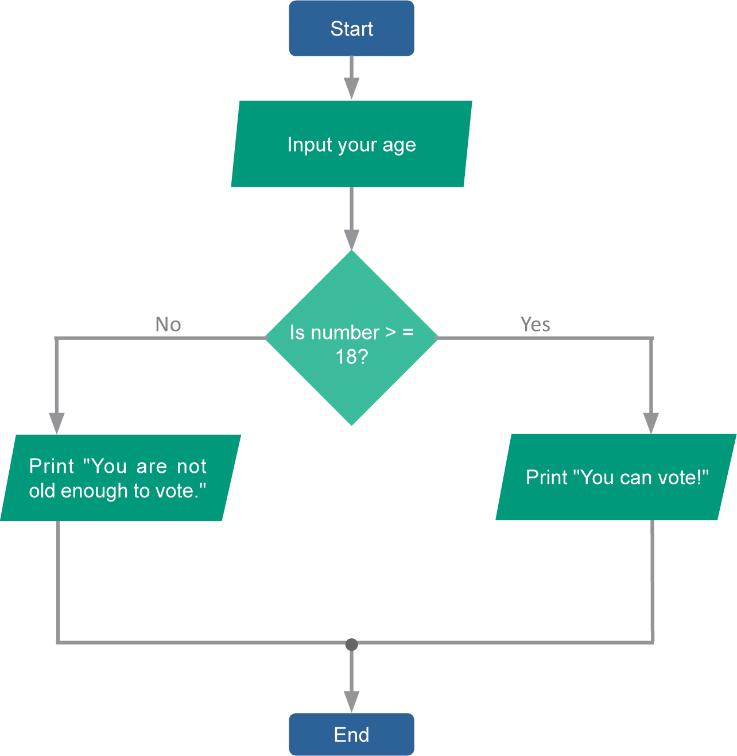
Flow Control (6 of 7)
A selection control structure tells a computer what to do based on whether a condition is true or false. A simple example of a selection control structure is the if…else command

Slide 61
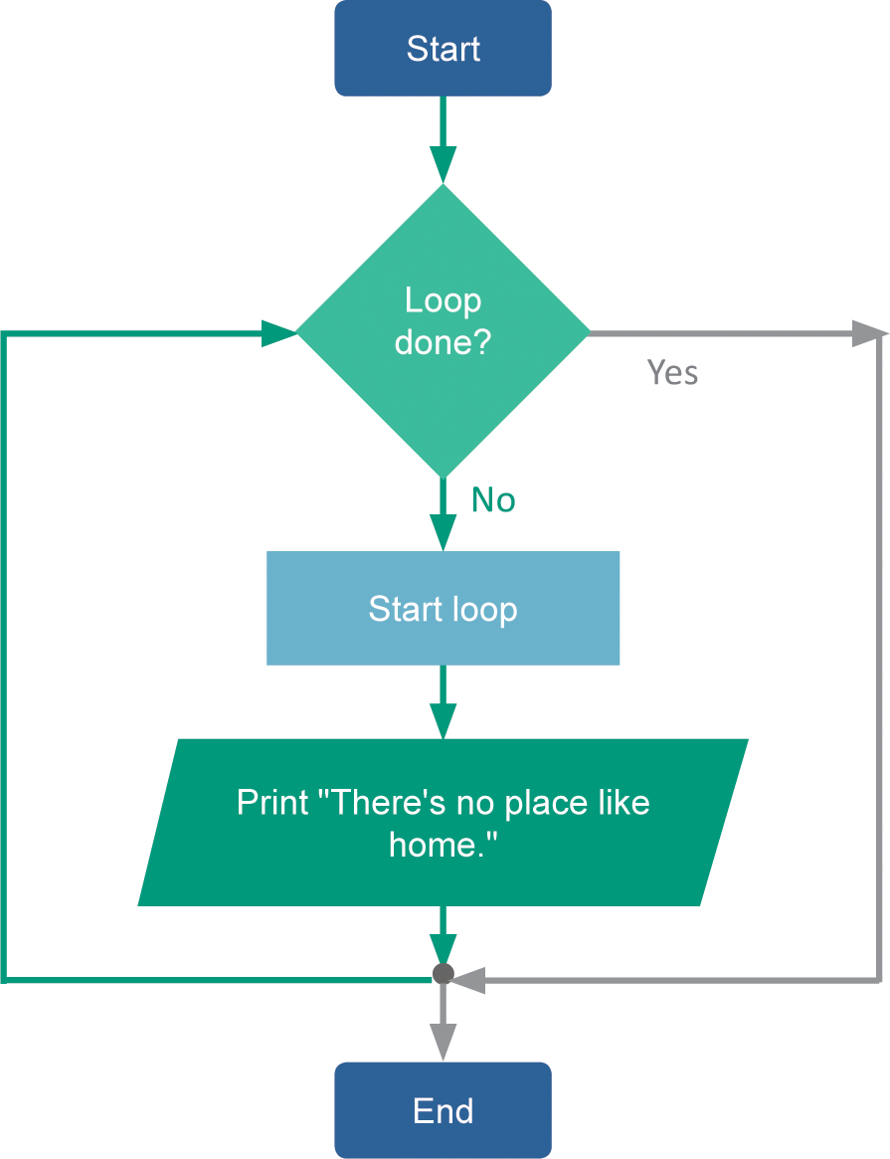
Flow Control (7 of 7)
A repetition control structure directs the computer to repeat one or more instructions until a certain condition is met
The selection of code that repeats is usually referred to as a loop or an iteration

Slide 62
Procedural Applications
Procedural languages encourage programmers to approach problems by breaking the solution down into a series of steps; the earliest programming languages were procedural
The procedural approach is best used for problems that can be solved by following a step-by-step algorithm
The procedural approach and procedural languages tend to produce programs that run quickly and use system resources efficiently
The procedural paradigm is quite flexible and powerful, which allows programmers to apply it to many types of problems

Slide 63
Section D: Object-Oriented Code
Objects and Classes
Inheritance
Methods and Messages
OO Program Structure
OO Applications

Slide 64
Section D: Objectives (1 of 2)
Explain the significance of objects and classes within the object-oriented paradigm
Define an example class called People with at least four attributes
Create two subclasses of People called Students and Instructors that inherit at least two attributes from the superclass
Draw a UML diagram that illustrates the concept of inheritance
Explain the relationship between methods and messages in an object-oriented program

Slide 65
Section D: Objectives (2 of 2)
Provide an example of polymorphism that relates to classes called People, Students, and Instructors
Explain the significance of main() in an object-oriented program
List at least three object-oriented programming languages
Explain how the concept of encapsulation relates to abstraction

Slide 66
Objects and Classes (1 of 4)
The object-oriented (OO) paradigm is based on objects and classes that can be defined and manipulated by a program’s algorithms
It is based on the idea that the solution for a problem can be visualized in terms of objects that interact with each other
Rather than envisioning a list of steps, programmers envision a program as data objects that essentially network with each other to exchange data

Slide 67
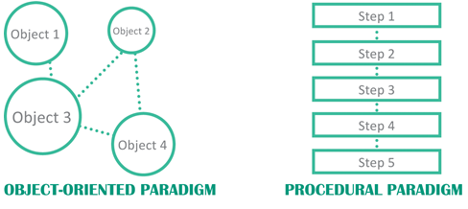
Objects and Classes (2 of 4)

Slide 68
Objects and Classes (3 of 4)
In the context of the OO paradigm, an object is a unit of data that represents an abstract or real-world entity, such as a person, place, or thing
Whereas an object is a single instance of an entity, a class is a template for a group of objects with similar characteristics

Slide 69
Objects and Classes (4 of 4)
A class attribute defines the characteristics of a set of objects
Each class attribute generally has a name, scope, and data type; its scope can be defined as public or private
A public attribute is available for use by any routine in the program
A private attribute can be accessed only from the routine in which it is defined

Slide 70
Inheritance
In OO jargon, inheritance refers to passing certain characteristics from one class to other classes
The process of producing new classes with inherited attributes creates a class hierarchy that includes superclass and subclasses
A superclass is any class from which attributes can be inherited
A subclass (or derived class) is any class that inherits attributes from a superclass

Slide 71
Methods and Messages (1 of 4)
In an OO program, the objects interact; programmers specify how they interact by creating methods
A method is one or more statements that define an action; the names of methods end in a set of parenthesis, such as compare() or getArea()
The code that is contained in a method may be a series of steps similar to code segments in procedural programs

Slide 72
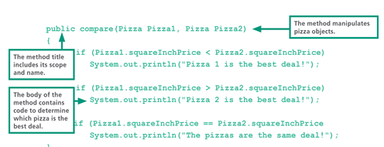
Methods and Messages (2 of 4)

Slide 73
Methods and Messages (3 of 4)
A method is activated by a message, which is included as a line of program code that is sometimes referred to as a call
In the OO world, objects often interact to solve a problem by sending and receiving messages
Polymorphism, sometimes called overloading, is the ability to redefine a method in a subclass. It allows programmers to create a single, generic name for a procedure that behaves in unique ways for different classes

Slide 74
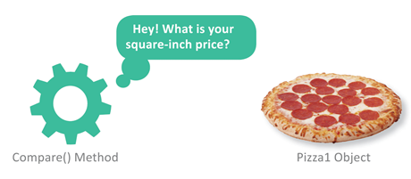
Methods and Messages (4 of 4)

Slide 75
OO Program Structure
For classes and methods to fit together they must be placed within the structure of a Java program, which contains class definitions, defines methods, initiates the comparison, and outputs results
The computer begins executing a Java program by locating a standard method called main(), which contains code to send messages to objects by calling methods

Slide 76
OO Applications
In 1983, OO features were added to the C programming language, and C++ emerged as a popular tool for programming games and applications
Java was originally planned as a programming language for consumer electronics, but it evolved into an OO programming platform for developing Web applications
Most of today’s popular programming languages, such as Java, C++, Swift, Python, and C#, include OO features

Slide 77
Section E: Declarative Programming
The Declarative Paradigm
Prolog Facts
Prolog Rules
Interactive Input
Declarative Logic
Declarative Applications

Slide 78
Section E: Objectives
Describe how the declarative paradigm differs from the procedural and object-oriented paradigms
Identify the predicate and arguments in a Prolog statement
Explain the difference between a Prolog fact and a Prolog rule
Identify constants and variables in a Prolog statement
Explain how Prolog uses goals
Draw a diagram to illustrate the concept of instantiation
List two types of projects, other than those mentioned in the text, that would be good candidates for a declarative language such as Prolog

Slide 79
The Declarative Paradigm (1 of 2)
The declarative paradigm describes aspects of a problem that lead to a solution
Programmers using declarative languages write code that declares, or states, facts pertaining to a program
Procedural paradigms | Object-oriented paradigm: | Declarative paradigm:
Programs detail how to solve a problem | Programs define objects, classes, and methods | Programs describe the problem
Very efficient for number-crunching tasks | Efficient for problems that involve real- world objects | Efficient for processing words and language

Slide 80
The Declarative Paradigm (2 of 2)
The programming language Prolog uses a collection of facts and rules to describe a problem
In the context of a Prolog program, a fact is a statement that provides the computer with basic information for solving a problem. A rule is a general statement about the relationship between facts

Slide 81
Prolog Facts (1 of 5)
Prolog programming is easy to use; the punctuation mainly consists of periods, commas, and parentheses, so programmers don’t have to track levels and levels of curly brackets
The words in the parentheses are called arguments, which represent one of the main subjects that a fact describes

Slide 82
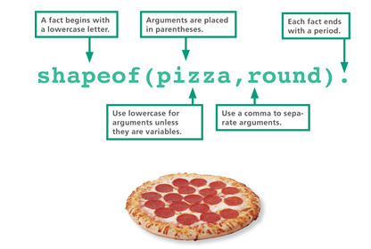
Prolog Facts (2 of 5)

Slide 83
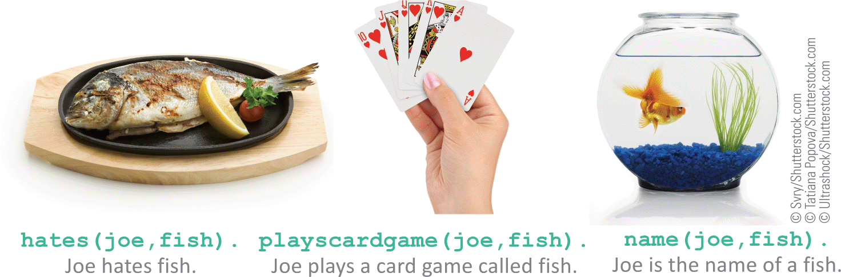
Prolog Facts (3 of 5)
The word outside the parentheses is called a predicate and describes the relationship between the arguments

Slide 84
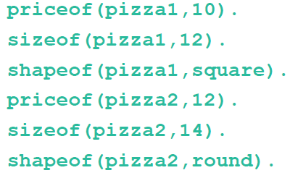
Prolog Facts (4 of 5)
Each fact in a Prolog program is similar to a record in a database, but you can query a Prolog program’s database by asking a question, called a goal
As an example, the following facts can easily be queried by entering goals:

Slide 85
Prolog Rules
With just facts and goals, Prolog would be nothing more than a database
The addition of rules gives programmers a set of tools to manipulate the facts
Unlike other programming languages, the order or sequence of rules in a Prolog program is usually not critical to making sure the program works

Slide 86
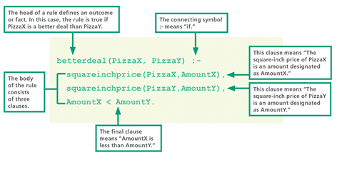
Prolog Facts (5 of 5)

Slide 87
Interactive Input (1 of 2)
In order for programmers to collect input from the user, they can use read and write statements
Read and write predicates collect user input
Prolog uses the write predicate to display a prompt for input
The read predicate gathers input entered by the user, and then creates a fact

Slide 88
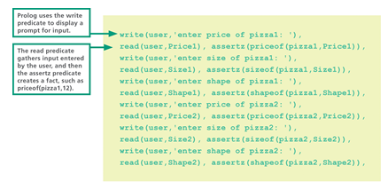
Interactive Input (2 of 2)

Slide 89
Declarative Logic (1 of 2)
Programmers need to determine how many conditions will apply to a program before starting to code facts and rules
A decision table is a tabular method for visualizing and specifying rules based on multiple factors
The decision table lays out the logic for the factors and actions and allows the programmer to see the possible outcomes

Slide 90
Declarative Logic (2 of 2)
Lowest Price? | Y | N | Y | N | Y | N | Y | N
Delivery Available? | Y | Y | N | N | Y | Y | N | N
Ready in less than 30 minutes? | Y | Y | Y | Y | N | N | N | N
Buy it? | Y | Y | N | N | Y | N | N | N
Each factor that relates to the pizza purchase is listed in the first column of the upper part of the table.
The remaining cells in the upper section of the table describe every possible combination of factors. This table has three factors for the decision. That means the table needs eight columns to cover all the combinations. This number is calculated as 2^{number of factors}. In this case, there are three factors, so 2³ is 2 * 2 * 2, or 8.
The lower part of the table lists actions that are taken based on the factors. The programmer looks at each column of Ys and Ns to decide if the action should be taken. For example, in the column filled with Ys, the action would be to buy the pizza

Slide 91
Declarative Applications
As a general rule, declarative programming languages are most suitable for problems that pertain to words and concepts rather than to numbers
Declarative languages offer a highly effective programming environment for problems that involve words, concepts, and complex logic
One of the disadvantages of declarative languages is that they are not commonly used for production applications—today’s emphasis on the OO paradigm has pushed declarative languages out of the mainstream, both in education and in the job market

